Slide 1
Elements

Slide 2

Contents
Origins of Elements
Our Philosophy
Team Members
Core Values
Business Models
Demos
Potential Clients
Competitive Advantages
Financial Needs
Our Visions

Slide 3
Origins of Elements
We are living in a world which is changing dramatically with innovative technology, and finance and investment industry are inevitably undergoing a transformation with the rising of artificial intelligence as well.
Our founders realized the trend is unstoppable and therefore we decide to create Elements to walk in the forefront of New Era rather than disappear in the memory of Old Times. By combining our expertise in value investing, macro asset allocation, quantitative finance and machine learning techniques, we are better equipped to make a new adventure altogether.

Slide 4
Our Philosophy
Theoretically, we withhold the basic assumption that market is efficient in the long-run but not completely efficient all the times. Due to the imperfection of the market mechanism, it would leave us some decent space to optimize the whole progress of investing in order to help investors outperform the corresponding benchmarks, without taking more risks in long-term investment horizons.
Empirically, we hold the common senses that value investing has the advantage of achieving absolute higher returns over Mr. Market, that modern portfolio is helpful to result in mean-variance optimization, and that artificial intelligence is more efficient in big-data analysis currently, and might become smarter than human beings in the whole investment progress in the future.

Slide 5
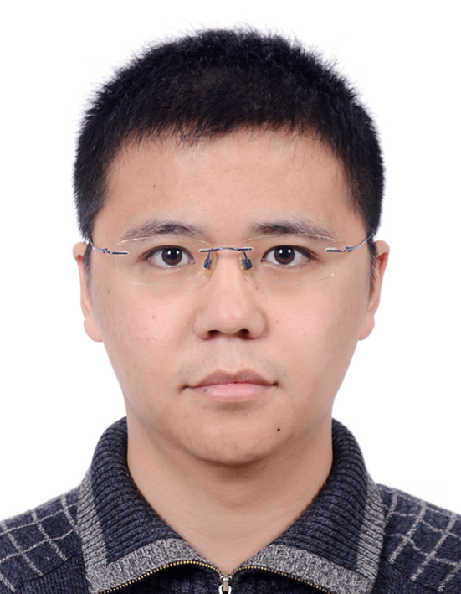
Team Members
Ji JIANG
Chief Executive Officer
Master of Financial Engineering, EPFL
Four years’ experiences in investment and managing a family & friend fund with 134.51% net return within one year and a half between January, 2016 and June 2017
Expertise: Value investing, Growth investing, Systematic investing, Equity valuation, & Risk management

Slide 6
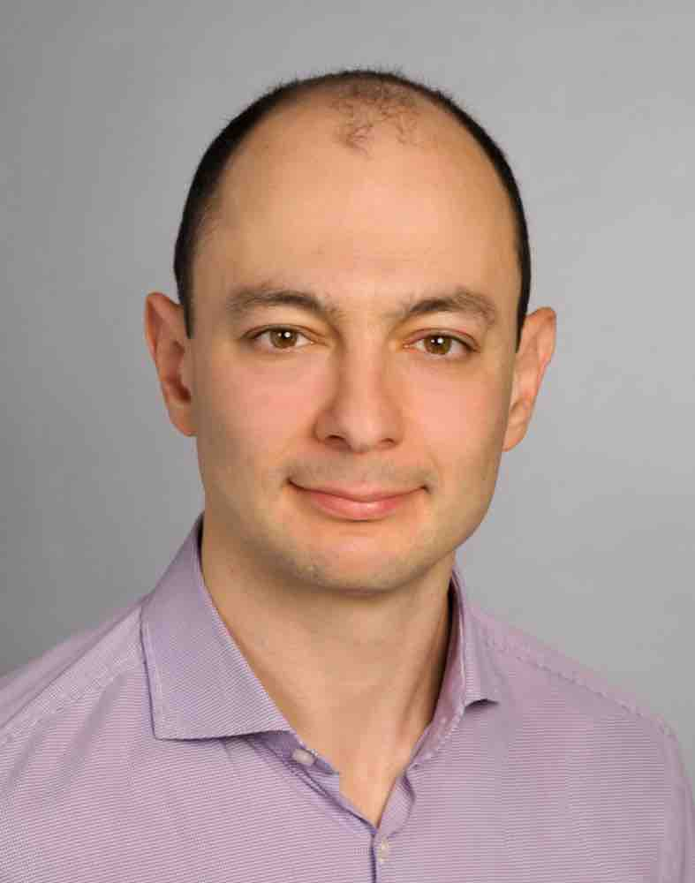
Team Members
Semyon MALAMUD
Chief Technology Officer
Associate Professor of Finance at EPFL and a Swiss Finance Institute Senior Chair.
He is a research fellow at the Bank of International Settlements and the Centre for Economic Policy Research (CEPR), and a Lamfalussy Research Fellow of the European Central Bank.
His research has received several awards, including the joint INQUIRE Europe/UK research prize, and the Dauphine-Amindi prize in Asset Management. In 2015, he received an ETF Research Academy award for developing the
first equilibrium model of ETFs.
Expertise: Asset and Portfolio Allocation, Quantitative strategies, Risk management, & Macro-economics

Slide 7
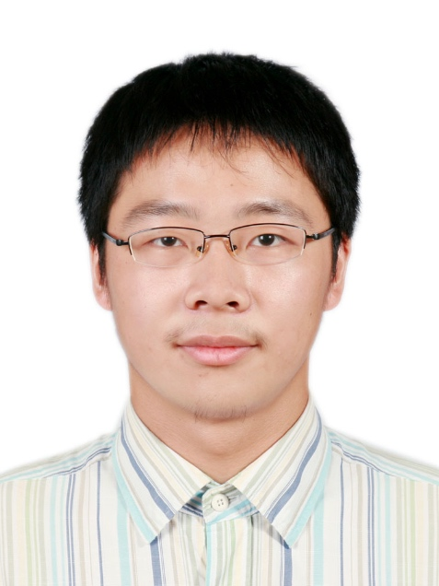
Team Members
Chenguang Xu
Chief Data Scientist
Master of Mathematics, EPFL
Master of Science, Imperial College London
Two-year experience of investing in equity, options, and currencies. Experiences of improving and developing quantitative trading strategies.
Experimental exercises of implementing topological data analysis in securities analysis and pricing.
Expertise: Quantitative Finance, Securities Pricing, Topological Data Analysis, and Machine Learning

Slide 8
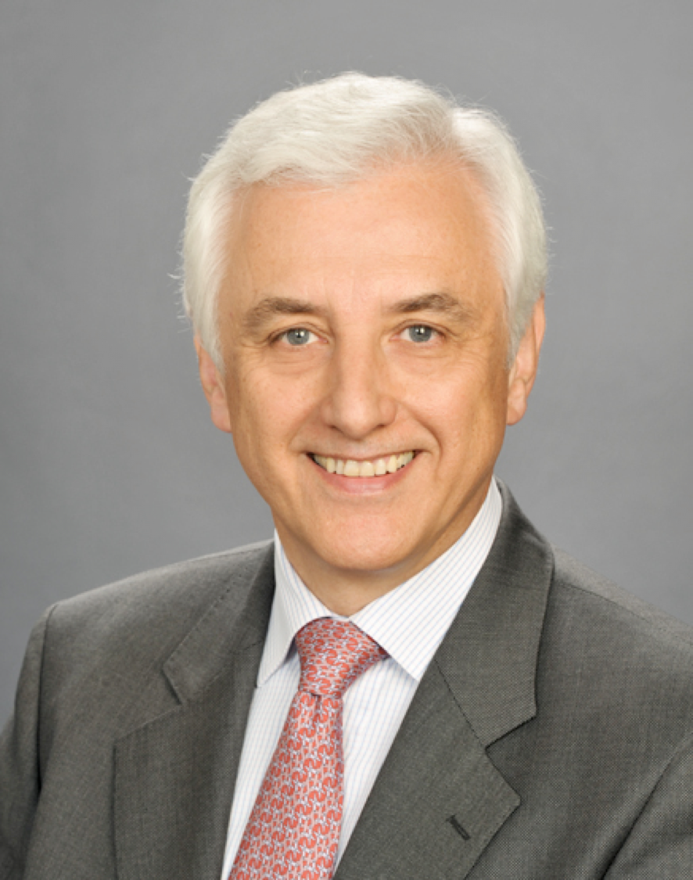
Team Members
André MISZCZUK, Swiss
Master in Industrial Economics and Law, UMCS
More than forty years’ working experiences in finance industry including 25 years in Capital International as Vice President
Expertise: Convertible bonds, Equity, Fixed-income, Currency and Macro-economy

Slide 9
Core Values
Integrity
Reason
Passion
Innovation
Humble
As an innovative pioneer in the investment industry, Elements will take reason, passion and innovation as the key engines for long-term development. Exposed to the general risks of financial markets, being humble is our general attitude in daily working. And integrity is our most important principle for serving clients.

Slide 10
Business Models
We provide proprietary Systematic Value Indexes for institutional and individual investors who are looking for mandates comparatively superior to passive indexes.
We provide customized Portfolio Optimization Services for institutional investors, by mainly covering Mean-Variance Optimization and Risk Management.
We provide customized Asset Allocation Strategy and investment advice for institutional investors and individual investors.
We support macro asset allocation and equity trading by providing Social Sentiment Prediction services.
We provide customized Data Mining and Securities Valuation powered by artificial intelligence.

Slide 11
Demo: Superiority of Systematic Value Indexes
Indices | ANNUALIZED RETURNS
 | 3 YRS | 5 YRS | 10 YRS | Since Inception
Systematic Value Index | 18.25% | 26.82% | 27.34% | 28.65%
Market Cap Index | 16.45% | 24.74% | 19.75% | 21.39%
Indices | ANNUALIZED VOLATILITIES
 | 3 YRS | 5 YRS | 10 YRS | Since Inception
Systematic Value Index | 26.39% | 27.73% | 35.32% | 34.89%
Market Cap Index | 26.08% | 26.87% | 35.29% | 34.87%
Indices | SHARPE RATIO
 | 3 YRS | 5 YRS | 10 YRS | Since Inception
Systematic Value Index | 0.65 | 0.89 | 0.76 | 0.79
Market Cap Index | 0.59 | 0.84 | 0.59 | 0.63
Indices | MAXIMUM DRAWDOWN
 | (%) |  | Period YYYY-MM-DD
Systematic Value Index | 55.11% |  | 2008.05.16-2008.11.20
Market Cap Index | 67.89% |  | 2007.11.05-2008.11.20
Notes: Market Cap Index is composed of Chinese companies which are traded in the USA and weighted by each company’s market cap
and Systematic Value Index is composed of the same group but weighed based on our systematic value platform. Both indexes are
rebalanced once a year and the testing data ranged from 2006.12.29 to 2017.7.31.

Slide 12
Demo: Application of Social Sentiment Prediction
Indices | ANNUALIZED RETURNS
 | 6 Monthes | 1 YR | 2 YRS | Since Inception
Social Sentiment Portfolio | 15.03% | 18.86% | 20.10% | 32.60%
S&P 500 | 16.67% | 21.12% | 11.29% | 8.23%
Indices | ANNUALIZED VOLATILITIES
 | 6 Monthes | 1 YR | 2 YRS | Since Inception
Social Sentiment Portfolio | 6.90% | 7.37% | 11.22% | 13.17%
S&P 500 | 6.84% | 7.27% | 11.17% | 12.61%
Indices | SHARPE RATIO
 | 6 Monthes | 1 YR | 2 YRS | Since Inception
Social Sentiment Portfolio | 1.89 | 2.13 | 1.46 | 2.05
S&P 500 | 1.84 | 2.35 | 0.81 | 0.53
Indices | MAXIMUM DRAWDOWN
 | (%) |  | Period YYYY-MM-DD
Social Sentiment Portfolio | 7.81% |  | 2015.10.21-2016.1.15
S&P 500 | 14.16% |  | 2015.5.21-2016.2.11
Notes: Social Sentiment Portfolio is basically a algorithm trading portfolio, based on our self-developed social sentiment predication platform. Here, we implement it in S&P 500 components. Before the opening of each trading day, every S&P 500 components will be assigned a social sentiment value based on the AI analysis of social media information from the websites. The ten stocks with the highest absolute social sentiment value will do daily trading. And each stock will take up 10% of the whole portfolio’s assets.

Slide 13
Potential Clients
NOW
In Three Years
QDII teams and Wealth Management Companies in mainland China
HNWIs in China & Switzerland
Mutual funds, Hedge funds,
Wealth Management Companies,
Individual Investors globally

Slide 14
Competitive Advantages
We have accumulated more than 50 years’ experiences of global investing.
We have mature techniques in quantitative finance to support index development and asset allocation strategy.
We have specific machine learning techniques practice.
We are leading in adopting advanced tool known as topological data analysis on financial data.
Our founders have abundant networks in multi-industries across Europe, China, USA and Japan.
Our founders have convenient accesses to cooperate with researching institutions of the highest academic level like EPFL, SFI, and ETH.

Slide 15
Financial Needs
We are looking for five million CHF as seed capitals, which would be used as below for the next three years.
 | Year One | Year Two | Year Three
General and Administration Expenses | 100,000 | 200,000 | 400,000
Marketing and Sales | 300,000 | 450,000 | 600,000
Research and Development | 400,000 | 800,000 | 1,600,000
Total | 800,000 | 1,450,000 | 2,600,000
Notes: G&A expenses will mainly cover office renting, raw data purchase, business trips and salaries for administrators; Marketing and Sales will mainly cover marketing of company services and products, PR services for company brand and sales fees through third-parties; R&D will mainly be used to recruit intelligent analysts in fundamental analysis, macro researching, quantitative finance and machine learning.

Slide 16
Our Visions
For the past two decades, passive index funds have attracted more and more investors globally as it could produce consistent higher returns generally than bonds, commodities and currencies. An estimate in October 2017 by Blackrock (the major provider for passive index funds in the world) showed that $11.9 trillion in stocks were owned by mutual funds, exchange-traded funds, institutional accounts and private investors that track an index. That accounts for 17.5% of the $67.9 trillion in global equity market capitalization. We believe that passive investing will remain attractive and it could be optimized by implementing investing techniques and machine learning techniques.
Our premier service is to provide systematic value index which is superior to passive index fund in mean-variance optimal over the long-term investment horizon. And we believe that the techniques, which we have been accumulating in market operating mechanism, value investing techniques, fundamental analysis, quantitative finance analysis and artificial intelligence will enable us to fulfill our ambition in asset management in the next decade.
By quantifying the traditionally empirical investment philosophy and implementing artificial intelligence in data mining and natural language processing, we believe that Elements will become an innovative asset manager for both individual and institutional investors globally by providing superior mean-variance optimal products without charging more on the management fees.

